Slide 1

HOSPITAL MANAGEMENT SYSTEM
Database Management System
Guided By:
Mrs. Indrakka Mali Mam

Slide 2
INTRODUCTION
The project “Hospital Management System” is developed using spring boot framework, which mainly focuses on basic operations. Like Inserting, Deleting, Updating and getting all records of Doctor and Patient information.
It is accessible by Receptionist. Only they can add and delete the data into the database. The data can be retrieved easily. The data are well protected for personal use and make the data processing very fast.
The project Hospital Management System included the registration of Patient, Storing the details into the system by using the database. The software has the facility to give a unique ID for every Patients and Doctors and stores the details of every patients and staff manually.

Slide 3

Objectives
Provides Better and Efficient Service.
Faster way to get information about the patients.
Provides facility for proper monitoring and less paper work
All details are available on a click.

Slide 4
Need Of HMS
To keep track of hospitals day-to-day activities & records of its patients, doctors that keep the hospital running smoothly & successfully there is need of Hospital Management System.
To digitalize all the version of the manual system.
To provide a paper-less hospital up to 80%, i.e. To provide low-cost reliable digitalization of the existing system.
To digitalize, the process of day-to-day activities like Registering New patient and Assigning a doctor to new patient etc.
To provide excellent security of data at every level of user-system interaction and also to provide robust & reliable storage facility.

Slide 5
Proposed System
The new system is to control the following information:
Patient Information.
Doctor Information.
Appointment Details.
These services to be provided in an efficient, cost effective manner, with the goal of reducing the time and resources currently required for such tasks.

Slide 6






Technologies Used
HIBERNATE
TOMCAT SERVER
POSTMAN

Slide 7

Modules in
HMS
DOCTOR MODULE
PATIENT MODULE
3. RECEPTIONIST MODULE

Slide 8

Features of Doctor Module
Add Doctor
View Doctor
DOCTOR
Update Doctor
Delete Doctor
View Patients

Slide 9

Features of Patient Module
PATIENT
View Their Details using their ID

Slide 10

Features of Receptionist Module
Add Patient
View Patient
Receptionist
Update Patient
Delete Patient

Slide 11
Postman Operations
GET : Obtain information
POST : Add information
PUT : Update certain information
DELETE : Delete information

Slide 12
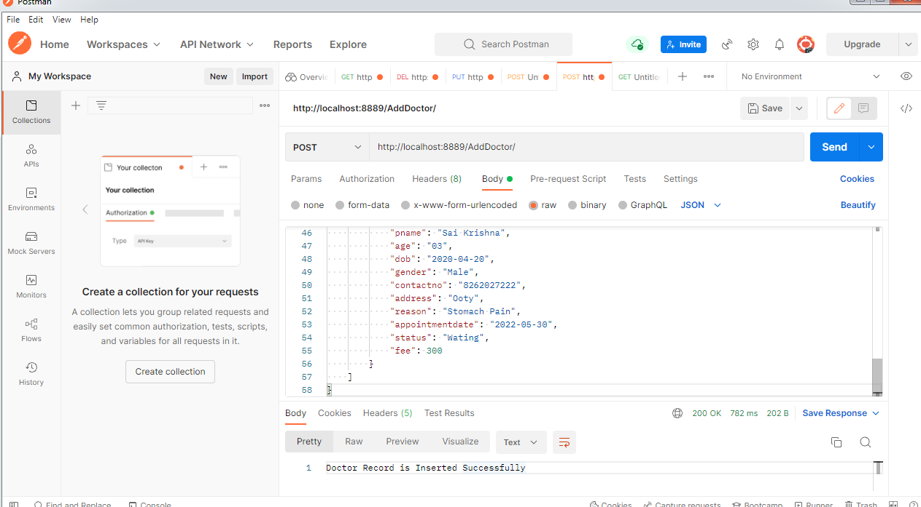
Screenshots
Insert Doctor and patient Record
Url: http://localhost:8889/AddDoctor/

Slide 13
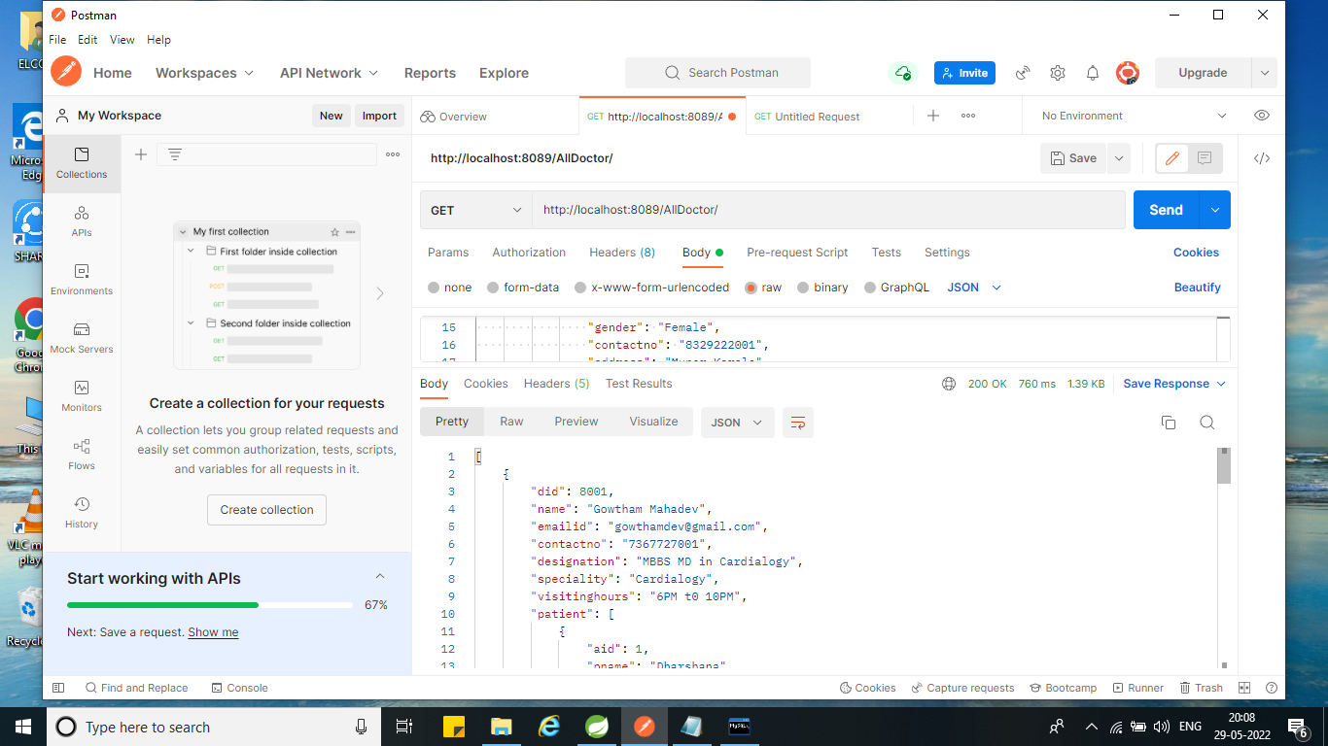
Get all Doctor record
Url: http://localhost:8889/AllDoctor/

Slide 14
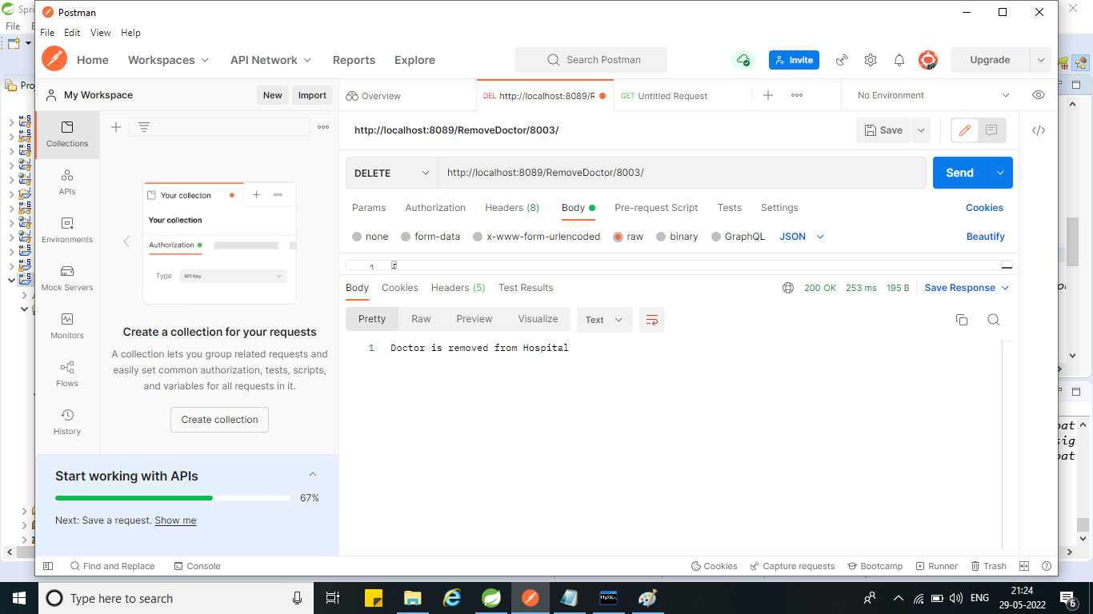
Delete the Doctor Record By Id
Url: http://localhost:8889/RemoveDoctor/8033/

Slide 15
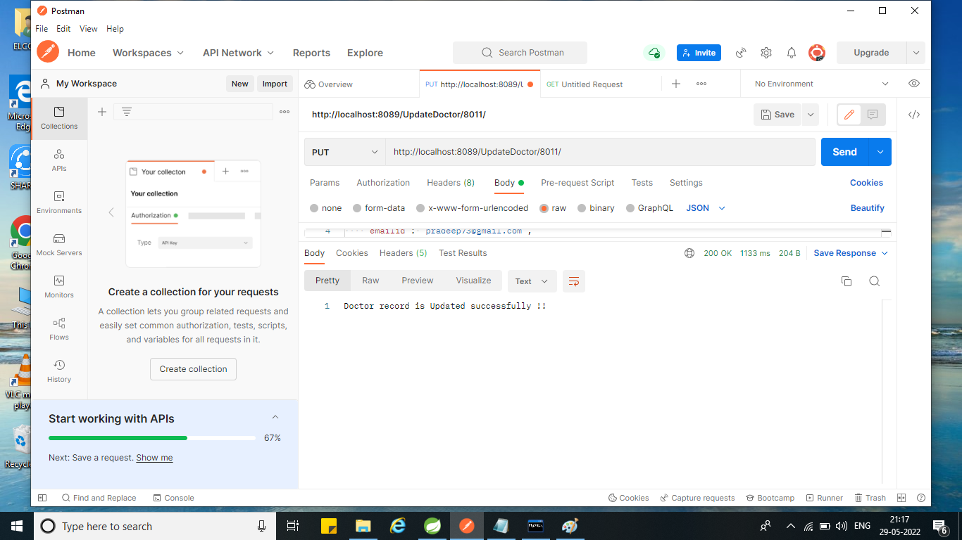
Update the Doctor Record ById
Url: http://localhost:8889/UpdateDoctor/8011/

Slide 16

Update the Patient Record ById
Url: http://localhost:8889/UpdatePatient/1/

Slide 17

If we want to show unavailable patient with their id then it is show exception like “please enter valid data to update the Record”
Url: http://localhost:8889/UpdatePatient/4/

Slide 18
Benefits of HMS
Records makes readable and understandable.
Eliminate redundancy in term of data storage. Data will be stored in a computer not heap of files.
Reduce the time wasted in retrieving data especially in finding a doctor’s personal details and patients past health records.
Increase Efficiency and Interactivity in any area of specialization in the hospital.
Able to quickly collect and edit data, summarize result and adjust as well as collect errors promptly.
For small or medical scale hospitals.

Slide 19

Feature Scope
To include Administration module
To include Login Validation
To Manage Patient IPD Section

Slide 20
Conclusion
Since we are entering details of the patients electronically in the “Hospital Management System”, data will be secured.
It easily reduces the book keeping task and thus reduces the human effort and increases accuracy speed.

Slide 21

Team
Members
Dharani M
Keshava Devi B
Priyadharshini K
Srimugi M
Tharani M

Slide 22
Thank You !

